Slide 1
Business Intelligence Part 2: Key Performance Indicators and Dashboards
Sources of material:
Sharda, Delen and turban – BI, Analytics and data science: a managerial perspective (4th ed.)

Slide 2
Learning Objectives
Define key performance indicators ad related terms
Highlight the role of dashboards in tracking key performance indicators
Use hands-on exercises to illustrate principles of good dashboard design

Slide 3
What are Key Performance Indicators (KPIs)?
Key performance indicators (KPIs) are business metrics that show the progress of a company’s business goals.
A metric is a unit of measurement that provides a way to objectively quantity performance.
Business metrics indicate whether a company has achieved its goals in a planned time frame.

Slide 4
What are Key Performance Indicators (KPIs)?
Measurement is the act of obtaining data associated with a metric.
Measures are numerical values associated with a metric.
KPIs are usually tracked on a KPI dashboard.

Slide 5
Performance Dashboards
Performance dashboards are commonly used in BPM software suites and BI platforms
Dashboards provide visual displays of important information that is consolidated and arranged on a single screen so that information can be digested at a single glance and easily drilled in and further explored

Slide 6
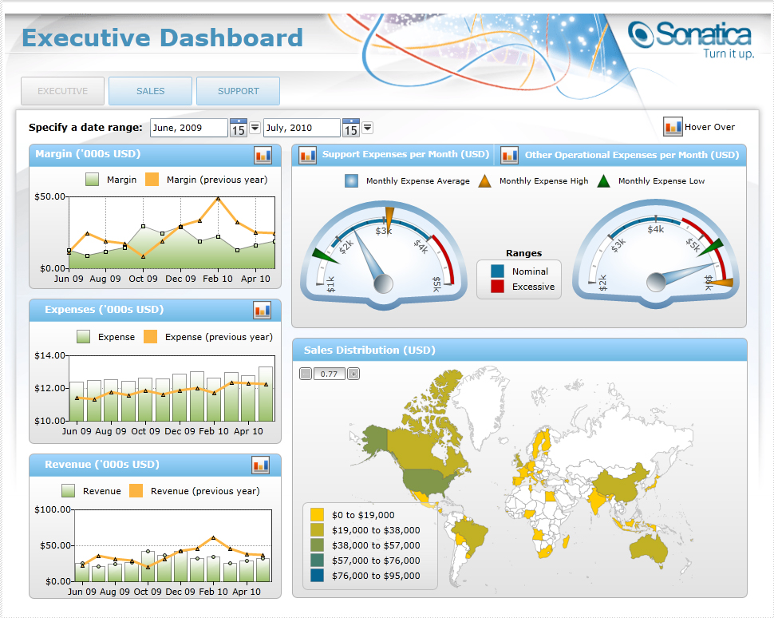
Performance Dashboards

Slide 7
Performance Dashboards
Dashboard design
The fundamental challenge of dashboard design is to display all the required information on a single screen, clearly and without distraction, in a manner that can be assimilated quickly
Three layer of information
Monitoring – graphical data to monitor key performance metrics
Analysis – summarized dimensional data to analyze the root cause of problems
Management - Detailed operational data that identify what actions to take to resolve a problem

Slide 8
Performance Dashboards
What to look for in a dashboard
Use of visual components to highlight data and exceptions that require action
Transparent to the user, meaning that they require minimal training and are extremely easy to use
Combine data from a variety of systems into a single, summarized, unified view of the business
Enable drill-down or drill-through to underlying data sources or reports
Present a dynamic, real-world view with timely data
Require little coding to implement, deploy, and maintain

Slide 9
Best Practices in Dashboard Design
Benchmark KPIs with Industry Standards
Wrap the Metrics with Contextual Metadata
Validate the Design by a Usability Specialist
Prioritize and Rank Alerts and Exceptions
Enrich Dashboard with Business-User Comments
Present Information in Three Different Levels
Pick the Right Visual Constructs
Provide for Guided Analytics

